Slide 1
Harp of Hermes: Traveler’s Ward
A safety application that empowers individuals to make smarter and safer decisions regarding mobility.
Team Name: Happy Data
Jinshan Yang, Weiqian Zhang, Sandra Rajoo, Weixing Nie

Slide 2
TABLE OF CONTENTS
01
02
03
Live Demo
Dataset and Techniques Breakdown
Business Case and Project Description

Slide 3

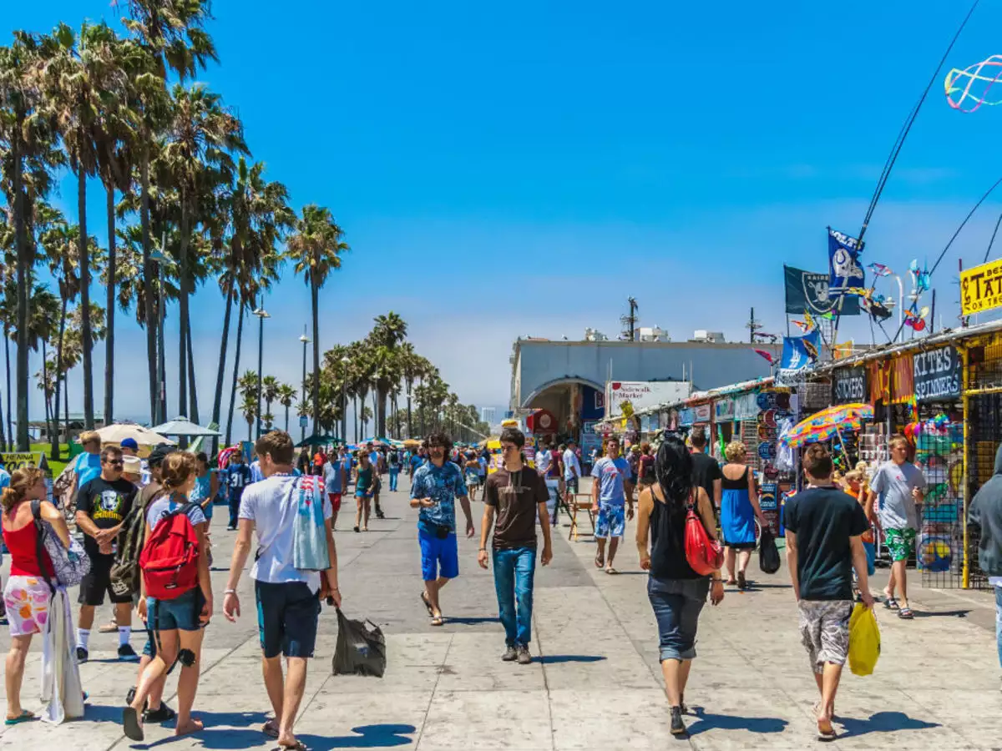
BUSINESS CASE
Los Angeles
VENUS
With increasing crime rates in Los Angeles, there raises the urgent need for building the efficient platform that empowers individuals to make safer decisions about their mobility.
Olympics
Tourists
Scholars and Students

Slide 4

OUR SOLUTIONS: Project description
Fast Responsive
Machine Learning
Meet our VOC
Improve Safety
Real-time and fast platform
Prediction based on past crime statistics and accurate model in real-time
Model satisfied various users and model should prevent prejudice opinion
Benefits visitors and residence having a safe experience in LA
Notes:
The platform leverages machine learning model to predict a safety score visualized on an interactive map based on past crime statistics and other relevant data.
Meanwhile, the platform utilizes computer vision on street-view images to generate a safety score based on factors like lighting, openness, public transportation, and security.
The model will also provide the fastest way to reach a safe spot in the case of an emergency.
The platform will utilize crowdsourcing employing a chatbot where users can submit information regarding the safety of a particular place, further used to improve predictions.

Slide 5
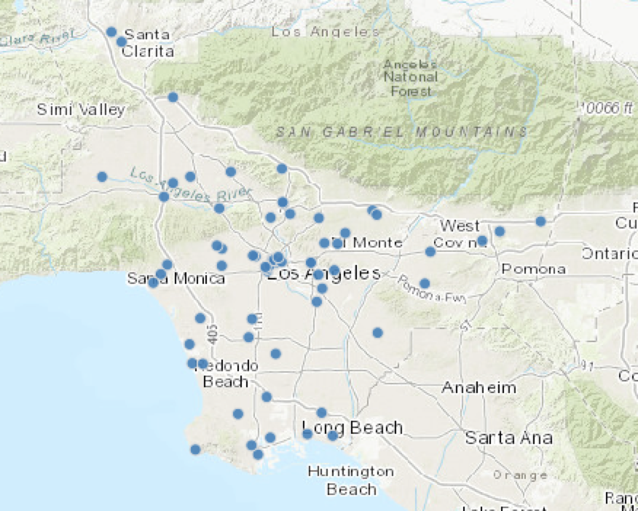
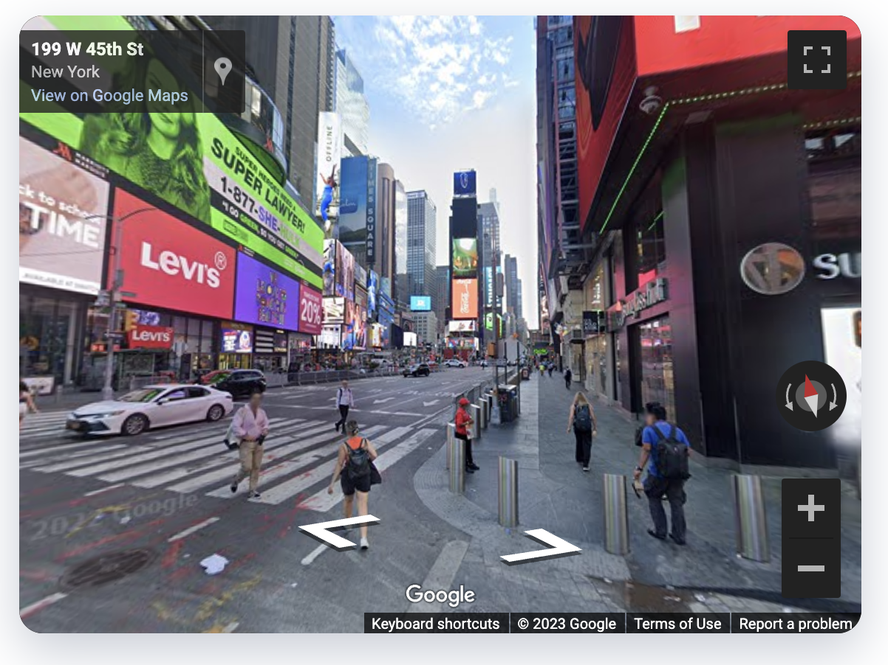

DATASETS
Geospatial Data
Los Angeles GeoHub
Historical Crime Data
Los Angeles Open data
LAPD crime records
Street view images of cities
Google Places API
Google Street view

Slide 6
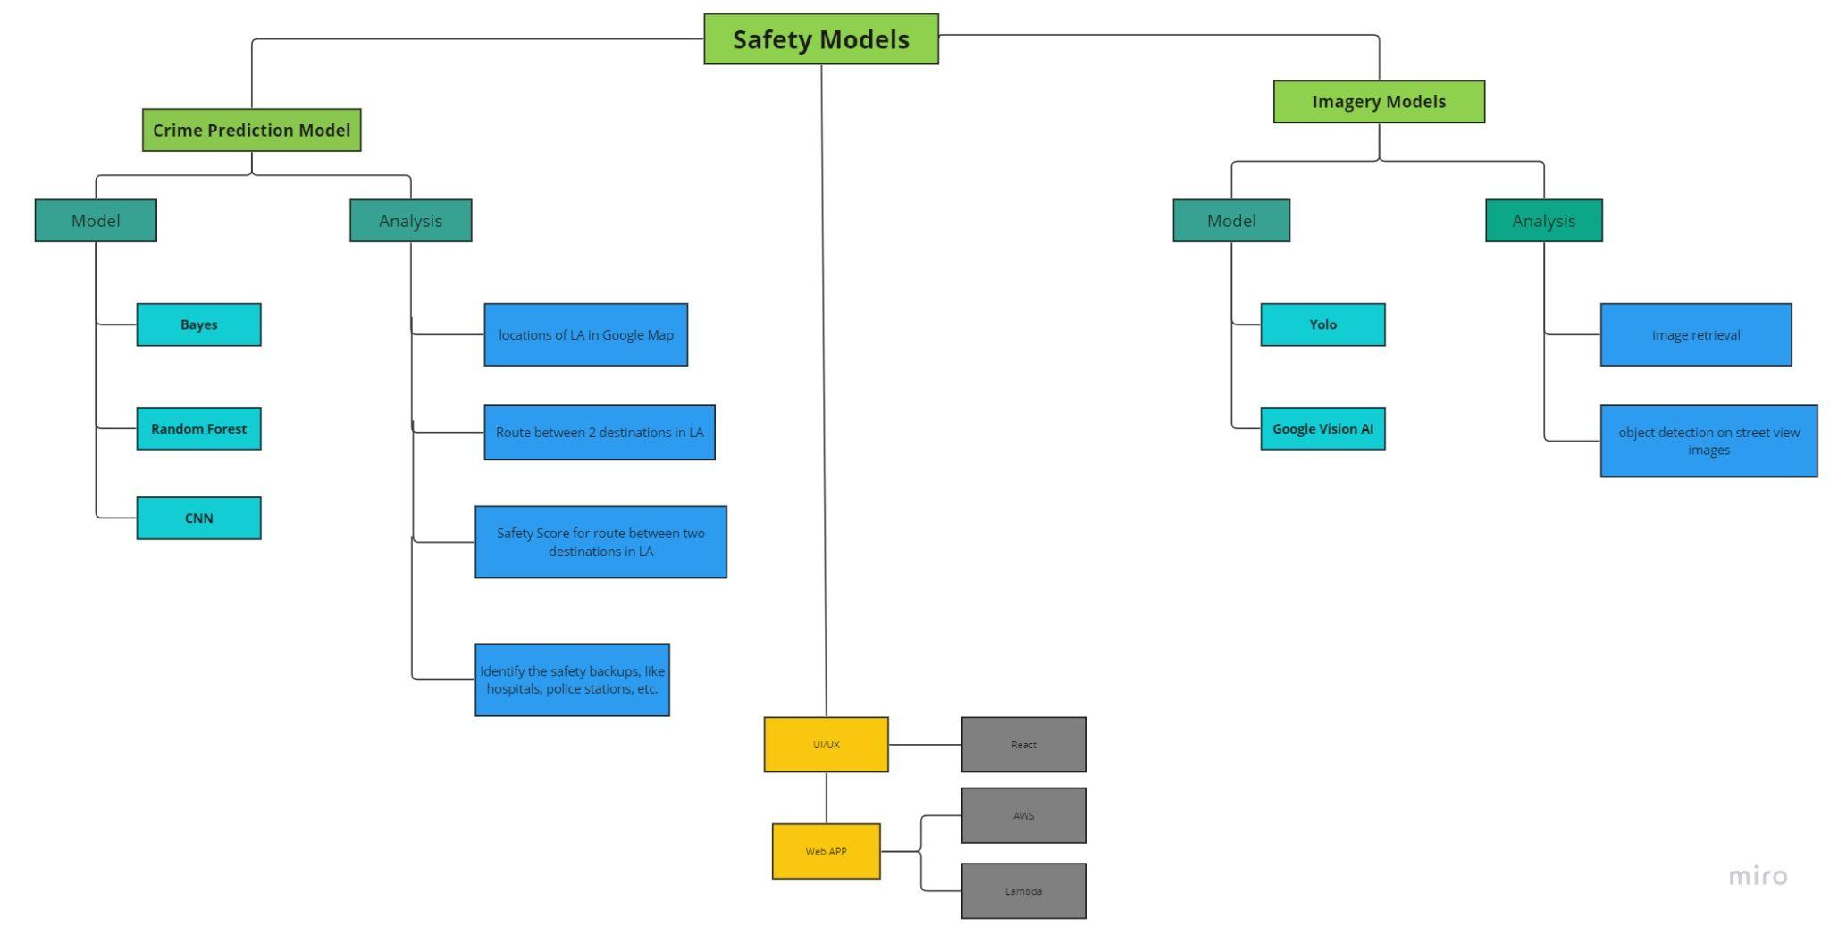
TECHNIQUE BREAKDOWN
Notes:
The platform leverages machine learning model to predict a safety score visualized on an interactive map based on past crime statistics and other relevant data.
Meanwhile, the platform utilizes computer vision on street-view images to generate a safety score based on factors like lighting, openness, public transportation, and security.
The model will also provide the fastest way to reach a safe spot in the case of an emergency.
The platform will utilize crowdsourcing employing a chatbot where users can submit information regarding the safety of a particular place, further used to improve predictions.

Slide 7
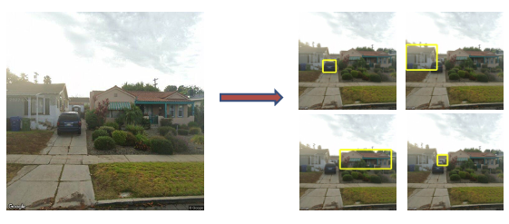
OUR RESULTS
Crime Prediction Model (Dataset)
Model | Evaluation Metric | Result
Bayes | Accuracy, FP rate | around 0.70, 0.8
Random Forest | Accuracy, FP rate | around 0.73, 0.8
Crime Prediction Model (SMOTE)
Model | Evaluation Metric | Result
Bayes | Accuracy, FP rate | 0.33
Random Forest(violent) | Accuracy, FP rate | 0.60, 0.36
Random Forest(Property) | Accuracy, FP rate | 0.77, 0.15
Computer Vision Model: performs image retrieval and object detection on street view images using the Google Street View API and Google Vision API

Slide 8
OUR METHODS
Recalibration
Crime Area
Model
Webpage
Area
Safe Route
Crime Prediction
Webpage UI
Divide LA into 0.0015 * 0.0015 lat X Lon boxes
Avoid dangerous areas and direct a safer route
Route will be put in our model to predict risky area (including preference)
Safe Route shows up on the webpage

Slide 9
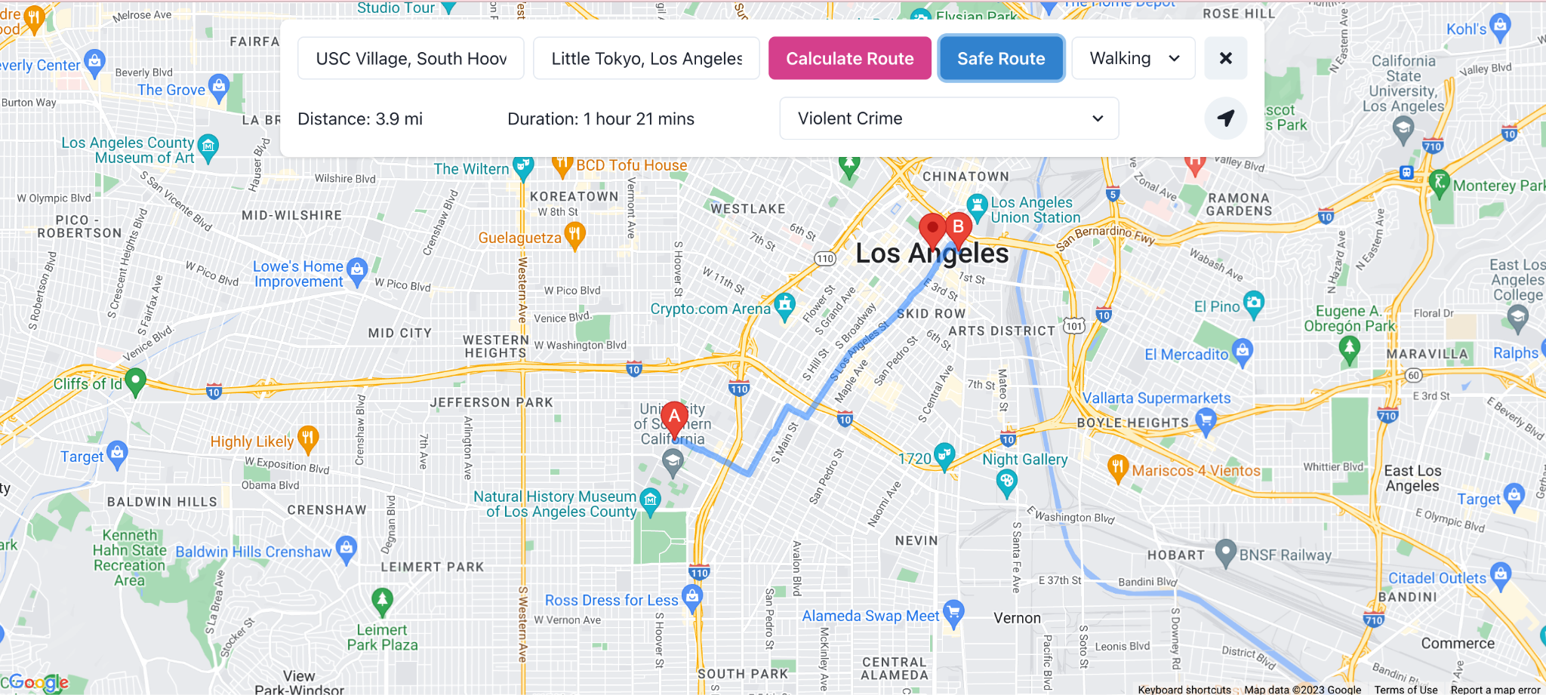
Demo

Slide 10
References
Chauhan, A. (2021). Crime Prediction and Analysis using Machine Learning. International Journal of Computer Sciences and Engineering, 9(5), 181-187. https://www.researchgate.net/publication/352878726_Crime_Prediction_and_Analysis_using_Machine_Learning
Guo, C., Wu, Q., & Yu, Y. (2021). A Multi-Objective Optimization Model for Public Safety Resource Allocation under Big Data. Journal of Systems Science and Information, 9(1), 30-49. https://link.springer.com/article/10.1007/s11518-020-5472-y
Mazumdar, C., Mukherjee, S., & Kundu, M. (2020). A Survey on Machine Learning Techniques for Crime Prediction. In Proceedings of the 5th International Conference on Computing and Communications Technologies (pp. 51-59). Springer. https://link.springer.com/chapter/10.1007/978-981-15-8308-7_5
Rodrigues, C., Amaral, M., & Correia, N. (2020). Urban Safety Prediction Model Based on Machine Learning: A Case Study in Porto. In Proceedings of the 9th International Conference on Computational Intelligence in Music, Sound, Art and Design (pp. 51-58). Springer. https://link.springer.com/chapter/10.1007/978-3-030-46512-4_7
Siddiqui, S., & Vashishtha, R. (2021). A Comparative Study of Machine Learning Techniques for Crime Prediction. Journal of Physics: Conference Series, 1892(1), 012076. https://iopscience.iop.org/article/10.1088/1742-6596/1892/1/012076/meta
Lu, X., Zhang, T., & Wang, Y. (2020). A machine learning approach to crime prediction: A case study of Denver, Colorado. Journal of Criminal Justice, 68, 101709. https://www.sciencedirect.com/science/article/pii/S0047235220301045
Williams, D., & Mckenna, R. (2019). Predictive policing and spatial crime patterns: A random forests approach. Policing: An International Journal, 42(1), 18-33. https://www.emerald.com/insight/content/doi/10.1108/PIJPSM-10-2017-0146/full/html
Liao, W., Luo, J., Xiao, J., Li, W., & Zhang, Y. (2019). Predicting the safety of urban street segments using street view images and deep learning. ISPRS International Journal of Geo-Information, 8(7), 322. https://www.mdpi.com/2220-9964/8/7/322
Chen, H., & Li, W. (2019). A deep learning approach for crime prediction using heterogeneous crime data. IEEE Access, 7, 19370-19379. https://ieeexplore.ieee.org/document/8682768
Chen, L., Li, M., Li, J., & Zhou, X. (2020). Safety score prediction of urban neighborhoods based on street view images and machine learning techniques. Sustainability, 12(5), 1837. https://www.mdpi.com/2071-1050/12/5/18377

Slide 11
Thank you

